Slide 1
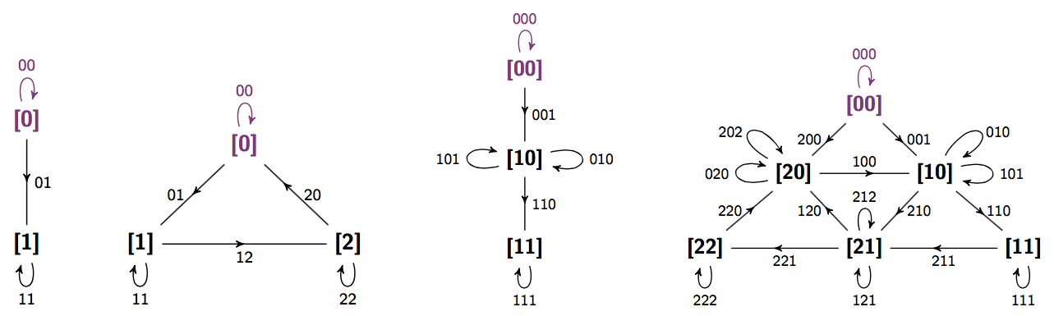
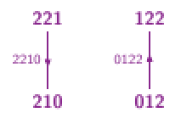
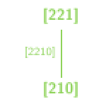
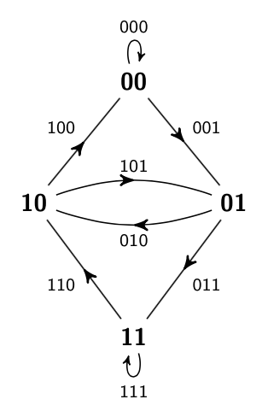
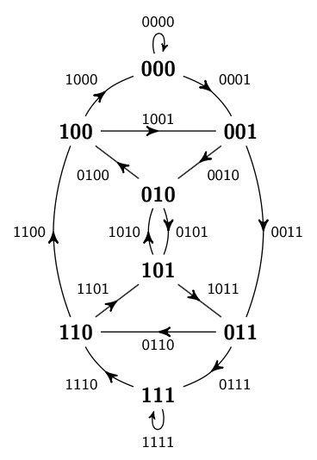
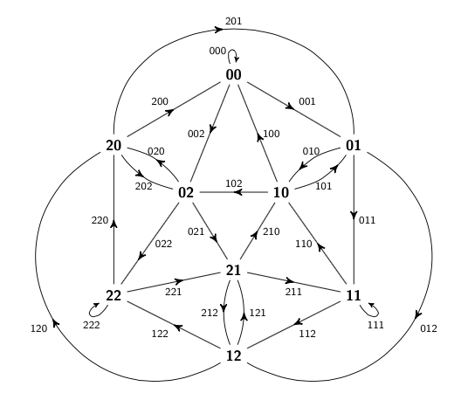
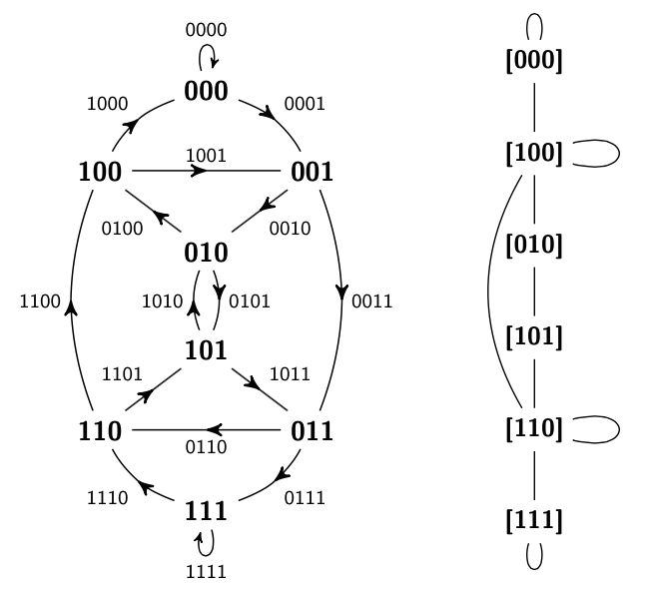
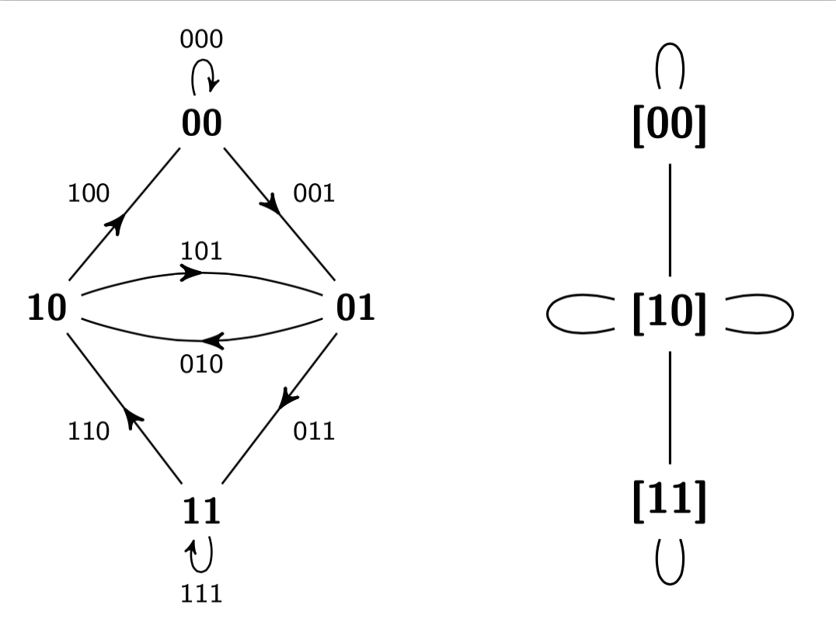
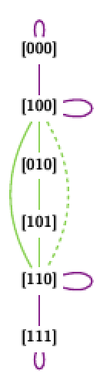
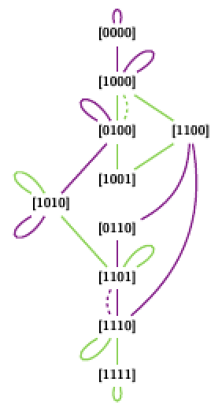
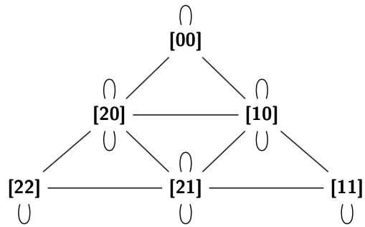
CONSTRUCTION AND OPTIMALITY OF UNORIENTED DE BRUIJN SEQUENCES
CHRISTIE BURRIS
COLORADO STATE UNIVERSITY
ORIGINAL DE BRUIJN SEQUENCES
CONSTRUCTION & COMPLEXITY
EXISTENCE
For positive integers k and n, does there exist a word which has as subwords every word of length n on k symbols exactly once?
Yes; a de Bruijn sequence B(k,n)! Its length-n subwords are exactly the set of k^{n} words of length n on k symbols. The length of such a sequence is k^{n} + n – 1. Consider the example where k = 2, n = 3.
B(2,3) = 0100011101
B(2,3) contains every binary word of length 3—010, 100, 000, 001, 011, 111, 110, 101—exactly once.
Constructing de Bruijn sequences from de Bruijn graphs Bg(k,n)
(a) Bg(2,3) (b) Bg(2,4) (c) Bg(3,3)
In the case of Fig. 1a, the sequence 0100011101 is formed by the Eulerian circuit
01 → 10 → 00 → 00 → 01 → 11 → 11 → 10 → 01
which corresponds to the subwords in the order seen above
010 → 100 → 000 → 001 → 011 → 111 → 110 → 101.
Forming unoriented de Bruijn sequences
As an original de Bruijn sequence is formed following an Eulerian circuit in a de Bruijn graph, an unoriented de Bruijn sequence of optimal length would be formed by following a path in a de Bruijn graph that traverses exactly one of the two edges corresponding to each reflected pair.
Complexity of unoriented de Bruijn graphs
Edges in the (k,n)-unoriented de Bruijn graph are identified by the pair of reflections that can be formed by the adjacent vertices. The case below holds in general.
As the graph is traversed, the subword that is seen in the sequence is determined by the direction taken on each edge. As such, the ability to traverse an edge is conditional upon which of the two length-(n – 1) words was previously traversed.
[11] → [21] → [21] → [21] → [22] [11] → [21] → [21] → [22]
112 → 121 → 212 → 122 112 → 121 → 122
In order to form a valid unoriented de Bruijn sequence, one must traverse an alternating Eulerian path – an Eulerian path that respects the above conditions.
Theorem 1. An unoriented de Bruijn sequence of optimal length uB(k,n) exists iff k is 2 or odd and n ≤ 3.
uBg(2,2) (b) uBg(3,2) (c) uBg(2,3) (d) uB(3,3)
Figure 3: Optimal unoriented de Bruijn sequences represented on unoriented de Bruijn graphs. Note that unoriented de Bruijn graphs are undirected. The paths taken on each graph (a) - (d) follow the directed edges, beginning at the constant 0 vertex (colored red).
The proof is constructed by counting ov(k,n), the number of odd-degree vertices in unoriented de Bruijn graphs. Only vertices for which exactly one of either the first or last (n−2) characters form a palindrome have odd degree. The count of such vertices is found by subtracting from (total #-vertices) the (#-vertices with the above property). For k even and greater than 2 and n greater than 3, there are more odd vertices than are allowed.
Table 2: Optimal Unoriented de Bruijn Sequences
 | n = 2 | n = 3
k = 2 | 0011 | 00010111
k = 3 | 0011220 | 00010111212020122200
Figure 1: Bg(k,n) with vertices corresponding to words of length (n – 1) on k symbols. Each edge conn-ects a word to each possible consecutive word in a sequ-ence. Beginning at any vertex, B(k,n) can be formed by tracing an Eulerian circuit—a path that sees every edge exactly once, and begins and ends at the same vertex.
FUTURE WORK
uB(k,n) of suboptimal length
What is the minimum length of existing unoriented de Bruijn sequences where either k or n is greater than 3? These sequences would be constructed in such a way that the minimum number of edges are repeated in uBg(k,n) in order for the resulting graph to have an alternating Eulerian path, as in Fig. 5.
(a) 00001011001111
(b) 00000100011101100101011111
(a) uBg(2,4) (b) uBg(2,5)
Figure 5 (top): Unoriented de Bruijn graphs with additional edges (dotted) that give rise to unoriented de Bruijn sequences of suboptimal length.
UNORIENTED DE BRUIJN SEQUENCES
Consider the sequence 00010111. This sequence has each of the binary palindromes of length 3 as subwords, 000, 010, 101, and 111, but only one member of each of the pairs {001, 100} and {011, 110}. Each non-palindrome word of length 3 appears either forwards or backwards exactly once. We call such a sequence an unoriented de Bruijn sequence of optimal length. Two words v and v’ are reflections or reflected pairs if v = v₁ v₂ … v_{n-1} v_{n} and v’ = v_{n} v_{n-1} … v₂ v₁. Table 1 provides the reflected pairs for k = 2, n = 4.
Definition An unoriented de Bruijn sequence uB(k,n) is a sequence of characters drawn from an alphabet Σ_{k} of k symbols that (i) contains as subwords a member from each of the length-n reflections on k symbols, and (ii) is of the shortest length amongst all such sequences satisfying property (i).
When read forward and backward, the uB(k,n) sequence sees every word of length n on k symbols. We say that an unoriented de Bruijn sequence of optimal length satisfies the additional property that (iii) it contains as subwords exactly one member from each of the length-n reflections on k symbols.
(a) Bg(2,3); uBg(2,3) (b) Bg(2,4); uBg(2,4)
(c) Bg(3,3); uBg(3,3)
Figure 2: Original de Bruijn graphs (left) and analogous unoriented de Bruijn graphs (right) which contain
(k^{n}+k^{n/2})/2 vertices labelled by the equivalence classes [v] of k-ary words of length (n – 1). There is an (undirected) edge [v] → [w] if v → w or v → w’ is a (directed) edge in the de Bruijn graph Bg(k,n).
Table 1: Reflected Pairs: k = 2, n = 4
w | w’ | w = w’
0001 | 1000 | 0000
0010 | 0100 | 0110
0011 | 1100 | 1001
0101 | 1010 | 1111
0111 | 1110
1011 | 1101
How optimal is suboptimal?
The length of an unoriented de Bruijn sequence is bounded above by
L(k,n) + (n –1)(ov(k,n)/2 –1).
Figure 6 (left): Plot of r(k,n), the ratio of the upper bound on the length of uB(k,n) to the length of B(k,n) over the range 2 ≤ n, k ≤ 10. Note the rapid convergence to 1/2 as n or k increases.
Length of unoriented de Bruijn sequences
The length of any optimal uB(k,n) sequence L(k,n), is the length required to see all palindromes of length n on k symbols and half of all non-palindromes.
L(k,n) = (k^{n} + k^{⌈n/2⌉} + 2n − 2)/2.
This work is supported by the NSF grant DMS- 1022635 to Patrick Shipman.

